Slide 1
COURSE : OBJECT ORIENTED PROGRAMMING LANGUAGE COURSE COORDINATOR : N.VENKATA RAMANA SIR TITLE OF THE PROJECT : TRAIN RESERVATION MANAGEMENT SYSTEM
LIST OF DEVELOPERS : M.Ganesh -2200520017
m.Madhan-2200520019
K.Hitendra-2200520003

Slide 2
ABOUT PROJECT
Reservation Management System using Java.
This system allows you to make online train reservations.
As more businesses try to streamline their booking process and offer their consumers a more convenient experience, online reservation systems have grown in popularity in recent years.
In this blog, we will discuss how to build an online reservation system using Java.
The online reservation system we will build a simple console-based application that allows users to make, view, and cancel reservations.
Online reservation systems have many advantages for businesses, including higher productivity, decreased effort, enhanced customer satisfaction, and the capacity to manage and track reservations in real-time.

Slide 3
FEATURES OF PROJECT:
In this we can allow users to make reservations for available resources, modify or cancel their reservations, confirmation or payment processing and Sends automated notifications and remainders to users about their reservations.
It Provides support for multiple languages to cater to diverse user requirements .
Allows administrators to manage resources or services, such as
1.Adding,
2.Updating or
3.Deleting resources,
4.Setting availability and
5.Managing pricing.
It may include features such as email notifications, SMS alerts, and in-app notifications.

Slide 4
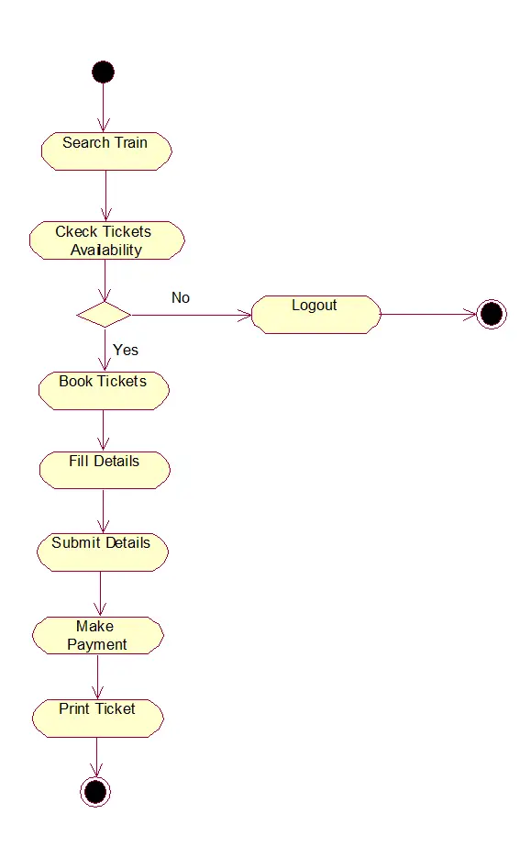

Slide 5
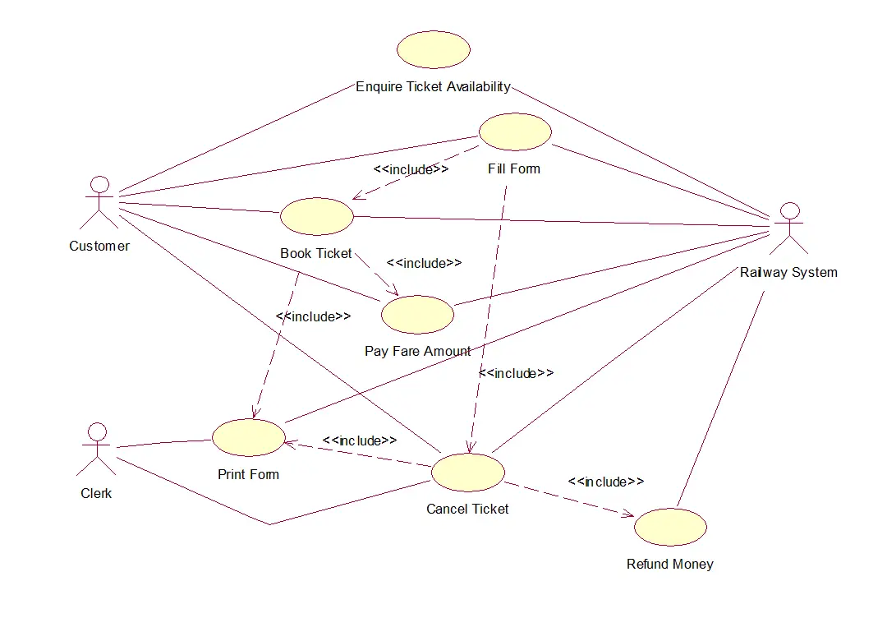

Slide 6
LIST OF CLASSES USED IN THIS PROJECT:
Reservation
Reservation Management System
LIST OF METHODS USED IN THIS PROJECT:
get ReservationId()
get PassengerName()
get TrainNumber()
get SeatNumber()
Confirm Reservation()
Cancel Reservation()

Slide 7
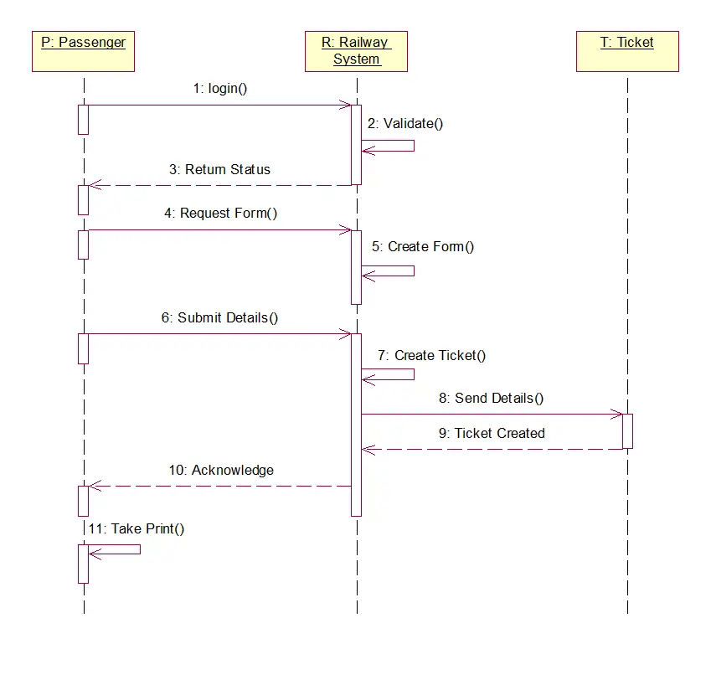

Slide 8
INTERFACES OF JAVA ON RESERVATION MANAGEMENT SYSTEM:
Train reservation System is a computerized system used to store and retrieve information and conduct transactions related to travel.
This software has two parts.
First is user part and the second is administrator part.
User part is used as a front end and administrator is the back end.
It will allow the customers to access database and allow new customers to sign up for online access.
The system displays all the train details such as train number, name, price and duration of journey etc. After search the system display list of available trains and allows customer to choose a particular train.
Then the system checks for the availability of seats on the train.
If the seats are available then the system allows the passenger to book a seat.
Otherwise it asks the user to choose another train.

Slide 9
ROLES AND RESPONSIBILITIES
Hitendra:
Guiding the team members.
Understand our team strengths.
Selecting the information need to solve problems or complete tasks.
Break down tasks into steps and put information in order.
Advises the team of upcoming plans and any anticipated changes.
The planner plans the time commitments of the team and makes sure it is aligned with the needs of customers.
Monitors team productivity.

Slide 10
M.Ganesh :
Find approach to the problem from another direction.
Deal well with distractions focused.
Find information and are proactive about doing so.
Task oriented and ask for advice or input when they are stuck on problem.
Work well with other people and listen to their suggestions.

Slide 11
M.Madhan :
They can follow instructions to get tasks done and see how these contribute to overall team goals.
Determine what needs to get done
Meet to discuss priorities on an ongoing basis
This includes summaries of work delivered, and reports.

Slide 12


Slide 13


